Slide 1

CLUSTERING POSTAL CODE AREAS IN HAITI
By Grégory PINCHINAT
July 19, 2020

Slide 2
Goals and Interests
Exploring venues on Foursquare and scraping other geographical data on Haiti on other sources as described in the before slide should allow to build a map on which post code areas (neighborhoods) of Haiti are properly clustered, based on most frequent venues around.
For entrepreneurs of all kind (touristic ones included), the map may reveal places that are already crowded with a given type of business and inspire for new ideas of investment.
For consumers of all kinds (especially local or foreign travelers), the map may serve as a guide to know which venues they may find in a radius of ten 10 kilometers around the area where they are headed to or where they already are.

Slide 3
Data & Methodology
The Data needed for clustering neighborhoods in Haiti Postal Codes, Postal Codes’ areas along with their administrative boroughs, which were scraped from Wikipedia.
Geographical coordinates were requested and obtained from various open sources such as OpenStreet Maps and Google Maps.
And finally, venues data were obtained from Foursquare.
K-Means Clustering was used to classify each neighborhood based on the most frequent categories of venues that may be found around them. Many neighborhoods could not be classified in any specific category, due to a lack of venue data. The unclassified were removed and finally only 80 neighborhoods were processed.

Slide 4
EXPLORATORY DATA ANALYSIS

Slide 5
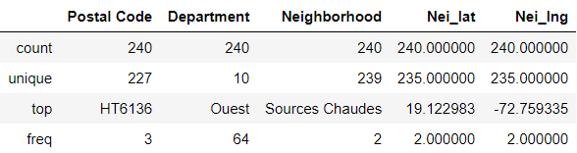
1. Neighborhoods
After wrangling, the Dataset was left with 240 entries.
With 227 unique postal codes, 10 unique boroughs (Departments: largest administrative division of the Haitian territory);
There were also 239 unique neighborhoods instead of 240, because one of them appears twice with different geographical information.
The department with the most neighborhoods remain the Ouest, it’s where the capital is located.

Slide 6
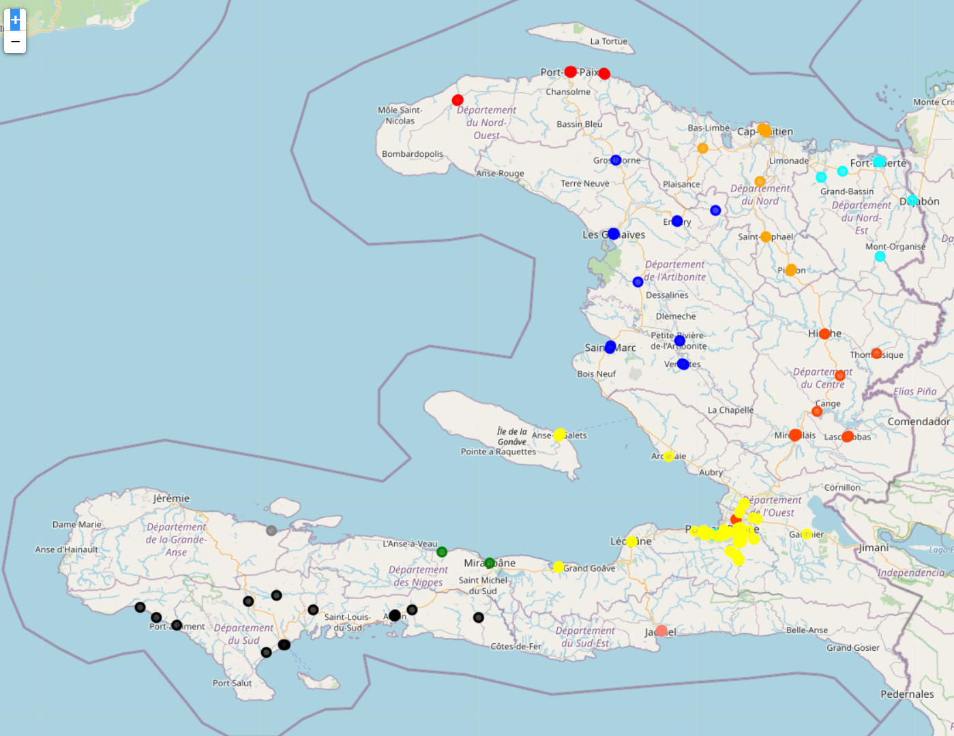
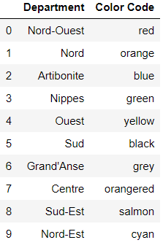
2. Venues
This map displays venues in a radius of 500 meters around neighborhoods in Haiti.
The markers are of 10 different colors to clearly identify venues around neighborhoods in each respective Department.
These markers are they appear on the map may be more than one.
For this map and every other which is snapshot in this document, an html version of the map is attached so it can be explored in more detail.

Slide 7
RESULTS

Slide 8





1. Description of Clusters
Cluster 1 : NIGHT CLUBS, groups all neighborhoods with nightclubs around
Cluster 2 : BARS & BOUTIQUES, groups all neighborhoods around which bars, bar restaurants, shops and other convenience stores are more likely to be found.
Cluster 3 : CREOLE RESTAURANTS, groups all neighborhoods around cajun-cuisine and/or creole-cuisine restaurants are more likely to be found.
Cluster 4 : HOSTING PLACES, groups all neighborhoods around which restaurants, diners, hotels, hotels that have a restaurant are more likely to be found.
Cluster 5 : PARKS, groups all neighborhoods around which parks and other public open-air meeting spots are more likely to be found.

Slide 9
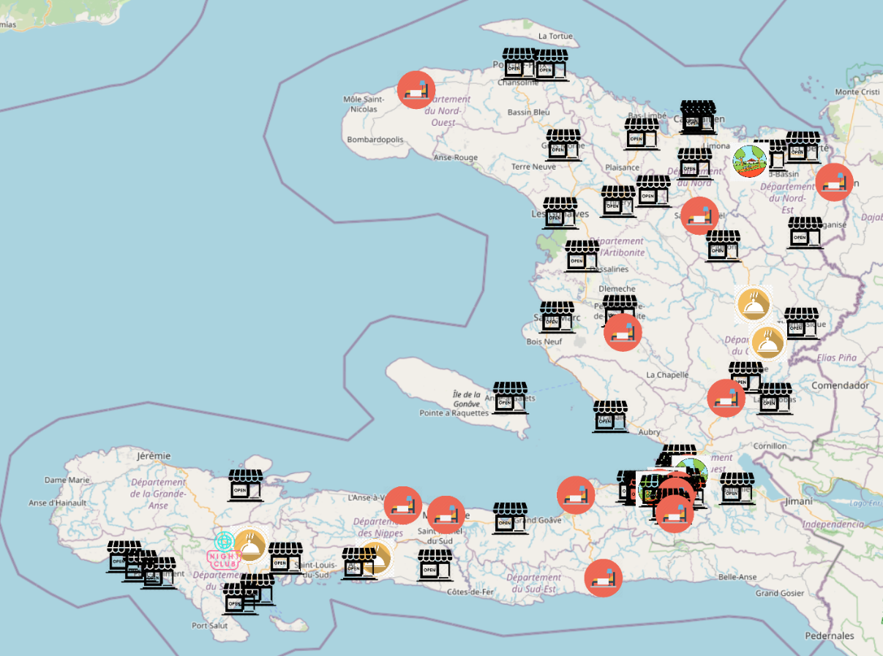
2. Final Map
The only night-club cluster on the map is constituted by “Camp-Perrin”, a city in the Department Sud.
The neighborhoods where most clusters are represented are located around the capital, “Port-au-Prince.
Bars and Boutiques are fairly represented throughout the territory, showing a preference for small businesses.
Hosting places are more likely to be found in coastal regions.
Creole restaurants are remarkable in two departments: “Centre” and “Sud”
Most parks and open-air meeting spots are found in the Metropolitan Area of “Port-au-Prince.

Slide 10
Discussion & Conclusion
The objective of this study was to cluster neighborhoods in Haiti in order to provide a tool to all kinds of users based on their interests (local tourism and investment on leisure or business). The neighborhoods were chosen by their attached postal codes, and neighborhoods with the same postal codes were taken individually.
Using a Foursquare Developer API access, venues in a radius of 500 meters around each of these neighborhoods were explored, then grouped by the similarity of the venues’ categories with K-Means Clustering Methodology, yielding 5 individual clusters. The algorithm did not completely converge, a lot of null values were returned. Those null values were dropped and only neighborhoods (80) assigned to a given cluster were kept for the rendering of the tool.
This study has limits: it is made in a country where technology is not really used, nor advanced, where 95% of businesses are not formal or do not have any digital imprint, and where there are very few assets invested.
This map may be quite useful for all planning purposes, but may not be representative of larger (greater than one-kilometer-wide) postal areas’ neighborhoods in Haiti.

Slide 11
Webo-Bibliography
https://fr.wikipedia.org/wiki/Code_postal_en_Ha%C3%AFti
www.openstreetmap.org
https://www.google.com/maps
https://foursquare.com/
https://tradingeconomics.com/haiti/foreign-direct-investment-net-inflows-percent-of-gdp-wb-data.html
Private Sector Assessment Report of Haiti, Inter-American Development Bank, 2014
https://datareportal.com/reports/digital-2020-haiti

Slide 12
ANNEX
https://github.com/gregpinchy/Coursera_Capstone_final.git

